Slide 1
Memory Classification

Slide 2
Semiconductor Memory Types
Random Access Memory (RAM)
Read Only Memory (ROM)
Programmable Read Only Memory (PROM)
Eraseable Programmable Read Only Memory (EPROM)
Electronically Eraseable Programmable Read Only Memory (EEPROM)
Flash Memory

Slide 3
Random Access Memory
RAM allows reading and writing (electrically) of data at the byte level
Two types
Static RAM
Dynamic RAM
Volatile

Slide 4
Read Only Memory (ROM)
Sometimes can be erased for reprogramming, but might have odd requirements such as UV light or erasure only at the block level
Sometimes require special device to program, i.e., processor can only read, not write
Types
EPROM
EEPROM
Custom Masked ROM
OTPROM
FLASH

Slide 5
ROM Uses
Permanent storage – nonvolatile
Microprogramming
Library subroutines
Systems programs (BIOS)
Function tables
Embedded system code

Slide 6
EPROM
Written to only with a programmer.
Erased with ultraviolet light
Positive
non-volatile storage without battery
can write to it, but only with aid of programmer
Negative
programmer requirements
Expensive
locations must be erased before writing

Slide 7
EEPROM
Written to with either programmer or the processor (electrically)
Erased with either a programmer or the processor (byte-by-byte electrically)
Positive
non-volatile memory without batteries
programmable a single-location at a time
Negative
Expensive
only smaller sizes available
extremely slow write times (10 mS vs. 100 to 200 nS)

Slide 8
Custom masked ROM
You send the ROM manufacturer your data and they mask it directly to the ROM
Use only when you are selling large volume of a single product
Positive
becomes cheaper to use for approximately more than 2000 parts
components come from chip manufacturer already programmed and tested taking out a manufacturing step
Negative
costs several thousand dollars for custom mask
software changes are costly
cannot be reprogrammed

Slide 9
OTPROM
Uses fuses that are burned to disconnect a logic 1 and turn it to a logic 0.
Written to by you using a programmer similar to EPROM
Once it's written to, the data is in there forever.
Positive
cheaper than EPROM due to cheaper packaging
more packaging options than EPROM due to less constraints like erasure window
standard "off-the-shelf" component
cheaper than Custom masked ROM up to about 10,000 devices
Negative – to reprogram, have to throw out the chip - Should only be used for stable design

Slide 10
FLASH
These memories are basically EEPROMs except that erasure occurs at the block level in order to speed up the write process
Non-volatile
This makes FLASH work like a fast, solid state hard drive
Positive
non-volatile
higher densities than both SRAM and DRAM
Negative
process of storing data is at a block level (and slower)
data cell must be erased before writing data to it

Slide 11
DRAM Operation
Address line active when bit read or written
Logic ‘1’ closes transistor switch (i.e., current flows)
Write
Voltage to bit line – High for 1 low for 0
Signal address line – Controls transfer of charge to capacitor
Read
Address line selected – transistor turns on
Charge from capacitor fed via bit line to sense amplifier
Compares with reference value to determine 0 or 1

Slide 12
Static RAM (SRAM)
Essentially uses latches to store charge (transistor circuit)
As long as power is present, transistors do not lose charge (no refresh)
Very fast (no sense circuitry to drive nor charge depletion)
Can be battery-backed – A small battery is piggy-backed to the RAM chip an allows data to remain even when power is removed (Not possible with DRAM)
More complex construction
Larger per bit
More expensive
Used for Cache RAM because of speed and no need for large volume or high density

Slide 13
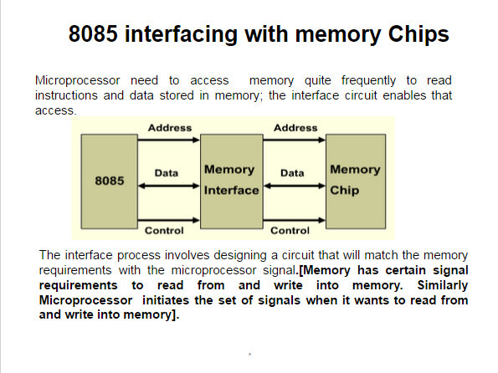

Slide 14
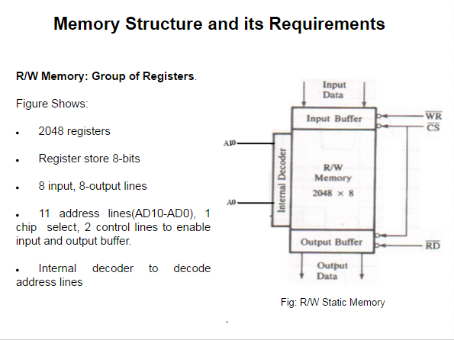

Slide 15
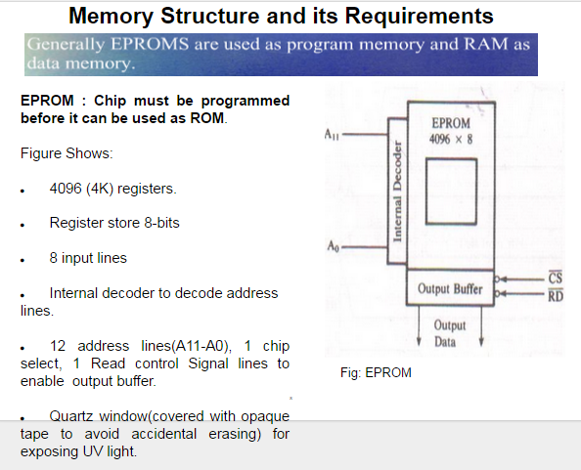

Slide 16
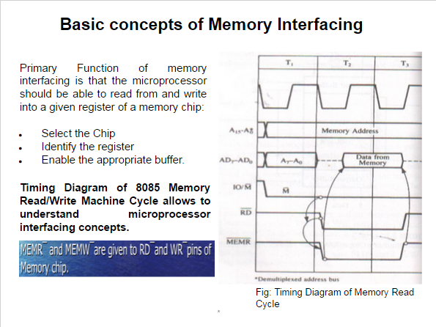

Slide 17
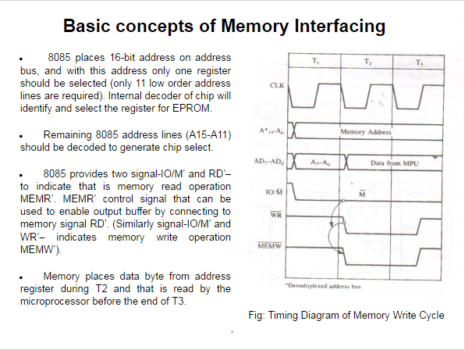

Slide 18
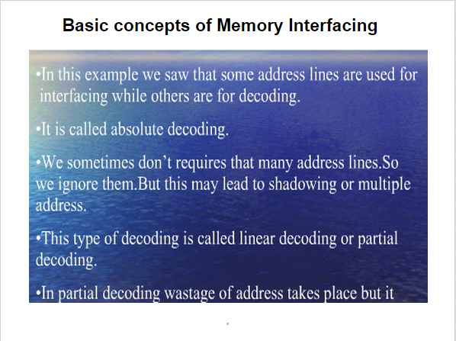

Slide 19
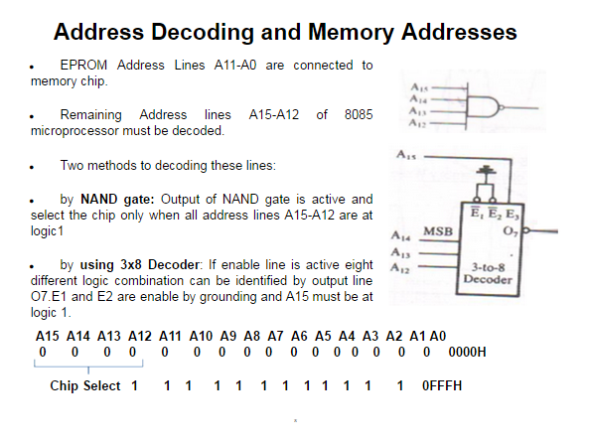

Slide 20
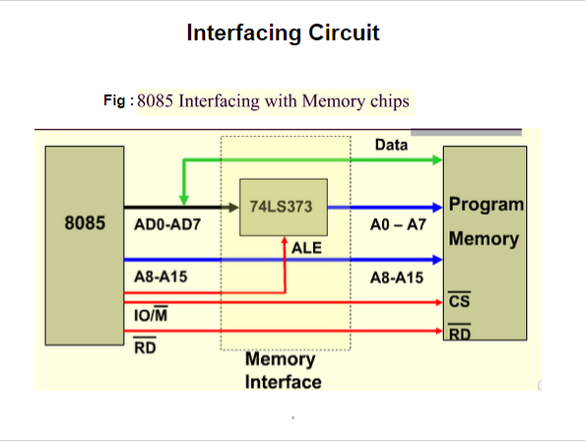

Slide 21
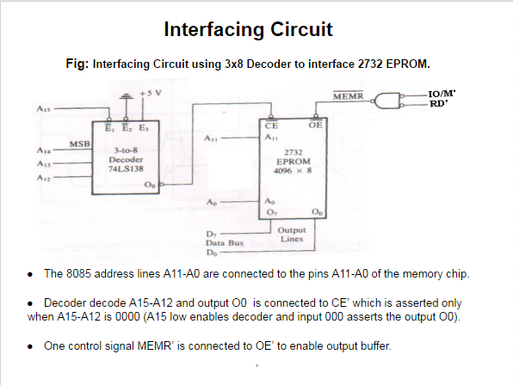

Slide 22
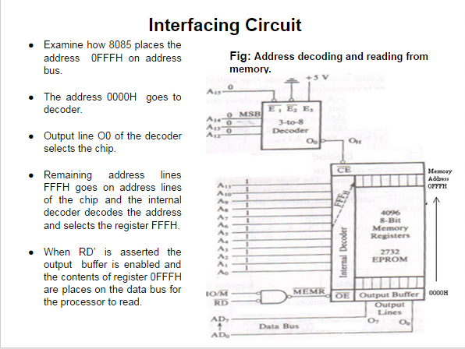

Slide 23
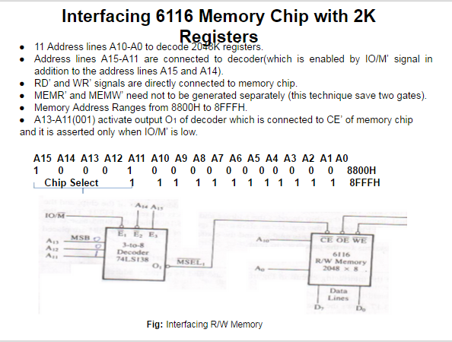

Slide 24
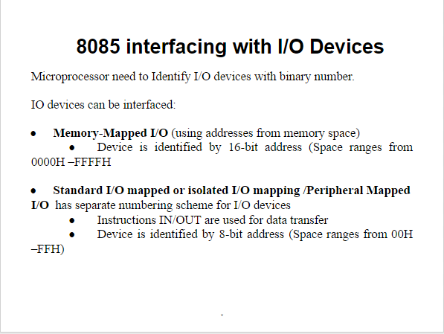

Slide 25
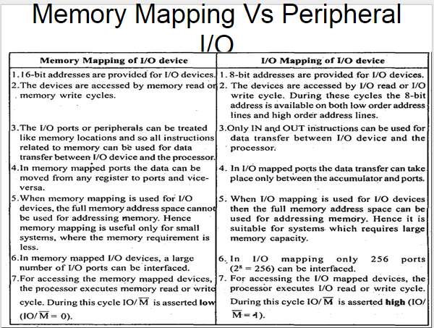

Slide 26
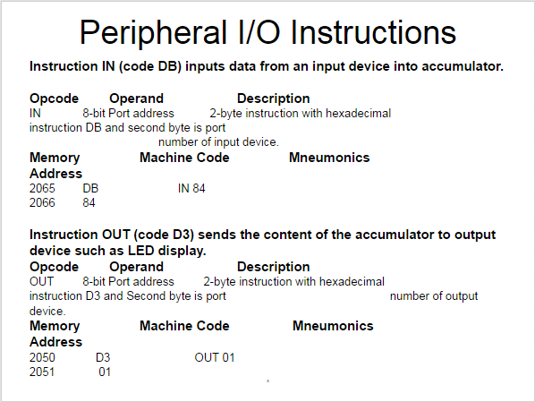

Slide 27
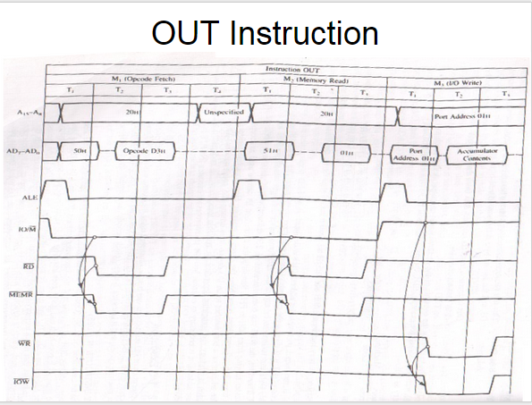

Slide 28
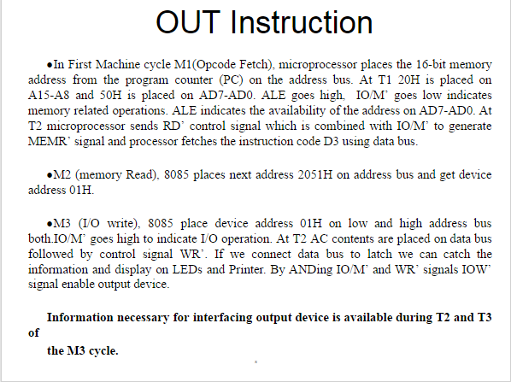

Slide 29
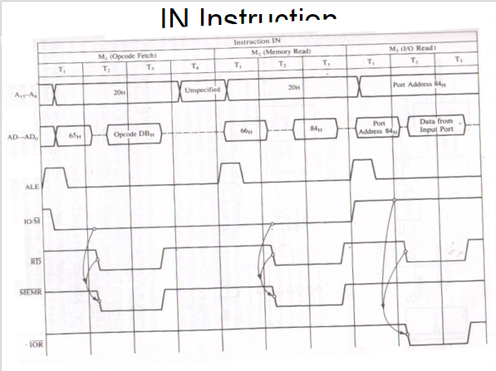

Slide 30
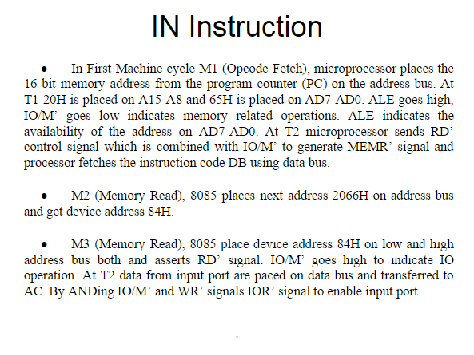

Slide 31
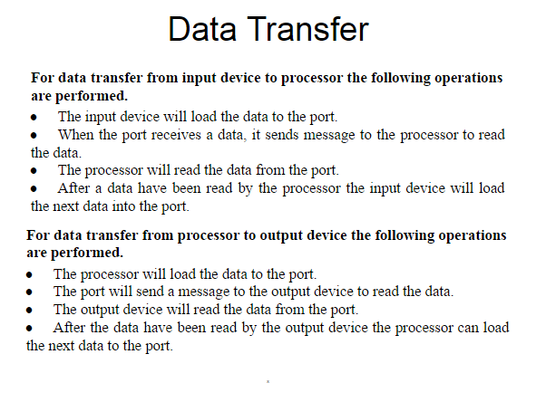

Slide 32
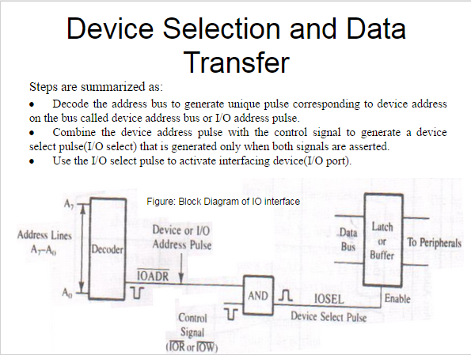

Slide 33
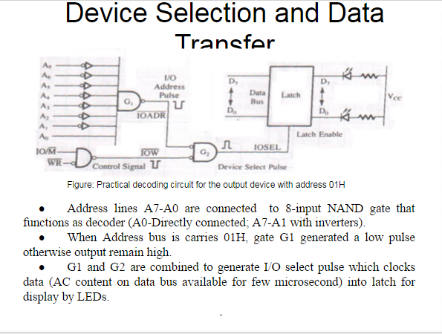

Slide 34
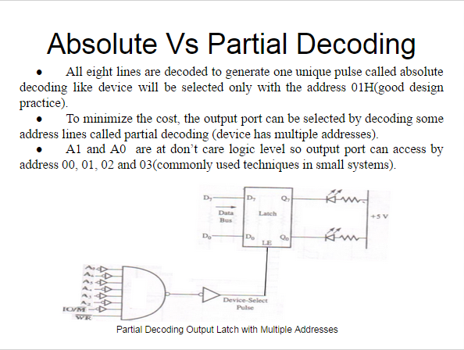

Slide 35
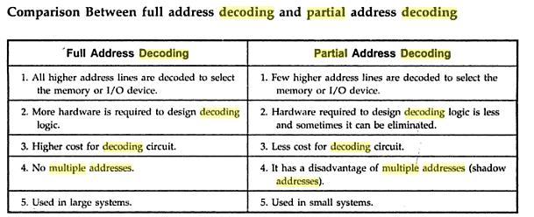

Slide 36
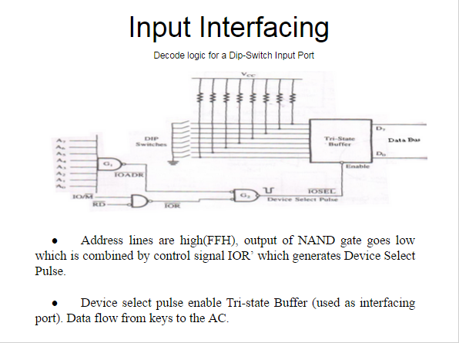

Slide 37
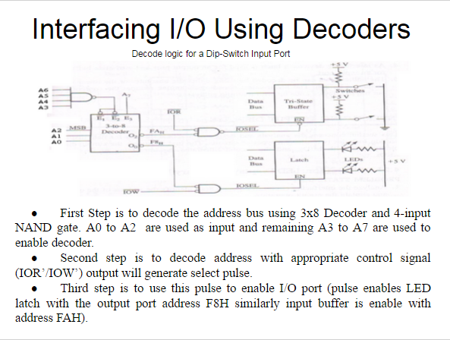

Slide 38
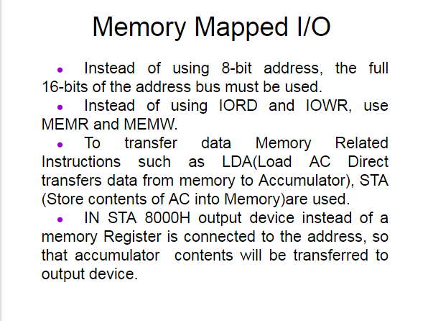

Slide 39
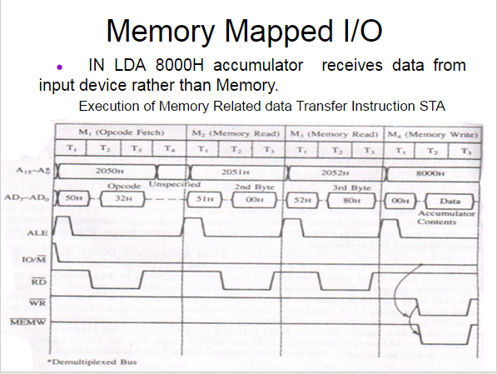
Fig: Timing Diagram for STA 8000.
For the timing diagram for LDA all are memory read.

